Slide 1
Cassandra @ Signal
How to handle billion requests a day with Cassandra without losing sleep
Aki Colović
Engineering Manager

Slide 2
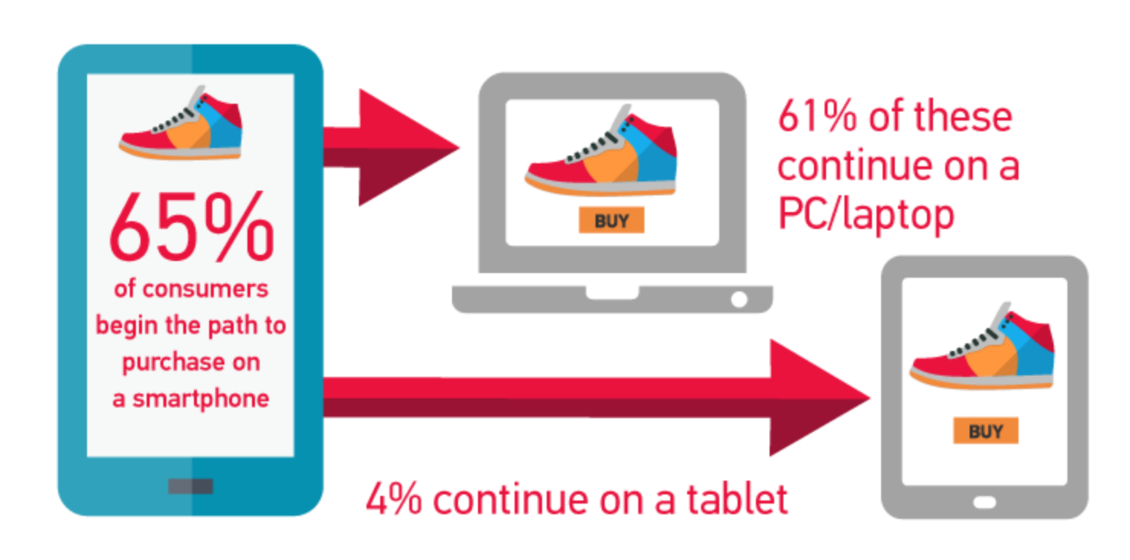
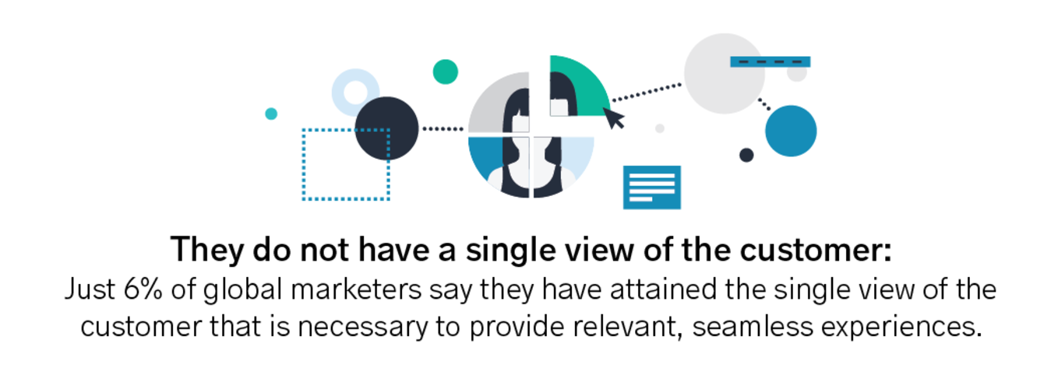

Slide 3

7.2 devices/person

Slide 4
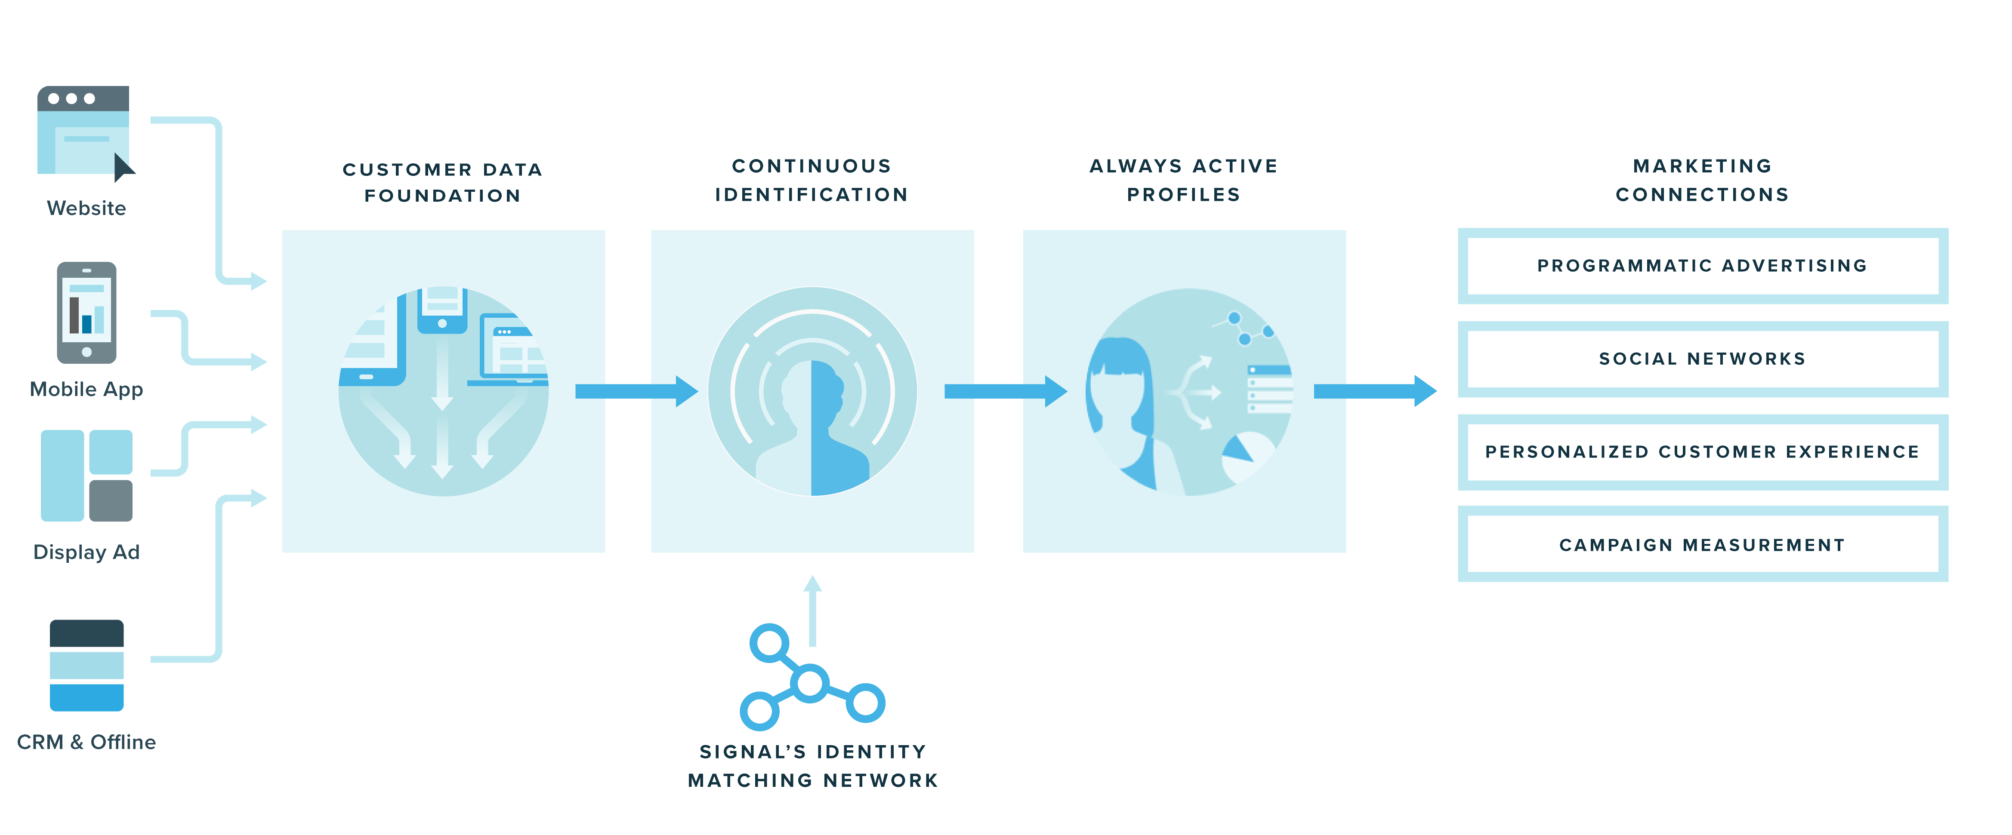
Platform for Digital Marketing

Slide 5






Our Partners

Slide 6


Apache Cassandra

Slide 7
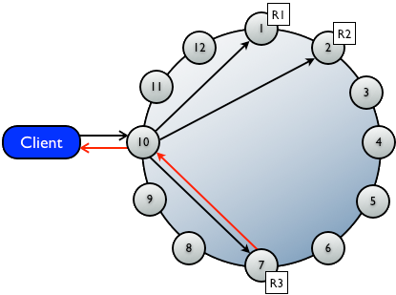
What is Cassandra DB?
- distributed NoSQL database
- asynchronous replication
- high availability
- easy to scale

Slide 8
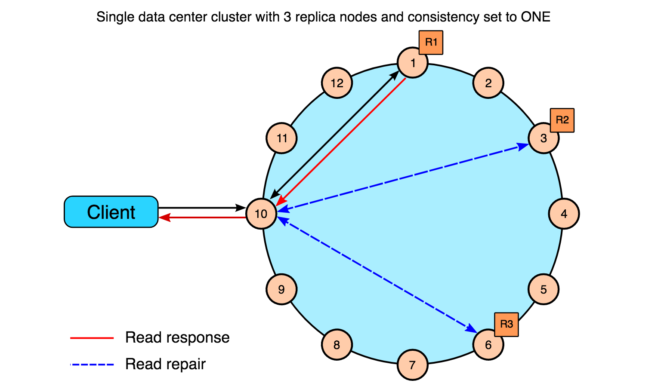
Read Example

Slide 9
US East
Tokyo
Asia/Pacific
US West
Europe
Sydney

Slide 10
Cassandra @ Signal
500+ Nodes
~1.5 billion queries per day
90.96+ TB of data

Slide 11
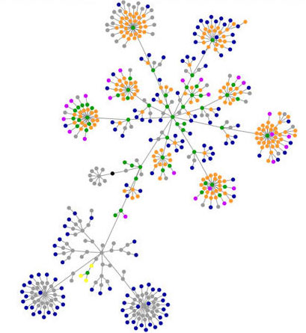
Signal’s Identity
Graph

Slide 12

HTTP API
Identity Service
HTTP API
Identity Service
HTTP API
Identity Service

Slide 13
Identity Service
Identity Service
Activation Service
Vendor Integration Service
Vendor Integration Service
Vendor Integration Service
Vendors

Slide 14
Advantages cont.
- tunable consistency
- decentralized
- production tested
- adding nodes increases read/write throughput linearly
- durable

Slide 15
Dealing With Failure
We've survived …
Amazon swallowing nodes
Amazon rebooting the internet
Disk Failures
Corrupt SSTables
Intra and inter region network issues

Slide 16

Any Downsides?

Slide 17

CQL !=

Slide 18
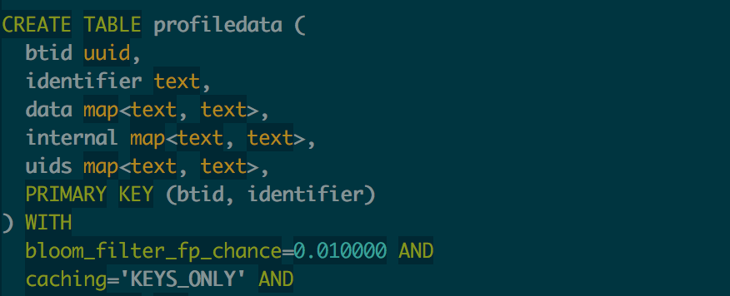
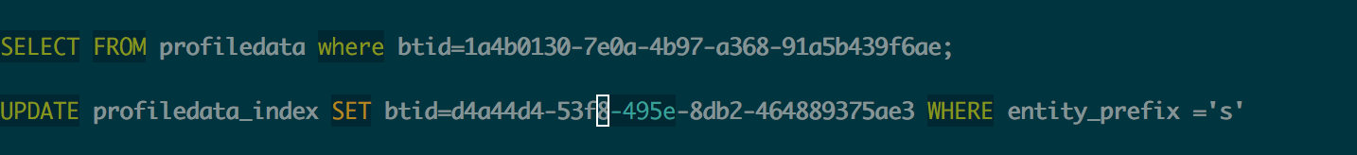
Cassandra Query Language

Slide 19

Data Modelling Pains
Watch Videos
Do some data modeling
Do it wrong

Slide 20
Final thoughts on modeling…
"The best way to approach data modeling for Cassandra is to start with your queries and work backwards from there. Think about the actions your application needs to perform, how you want to access the data, and then design column families to support those access patterns."

Slide 21
Secondary Index
- works well for low cardinality data
- does not scale
- material views( c* 3.0+)

Slide 22
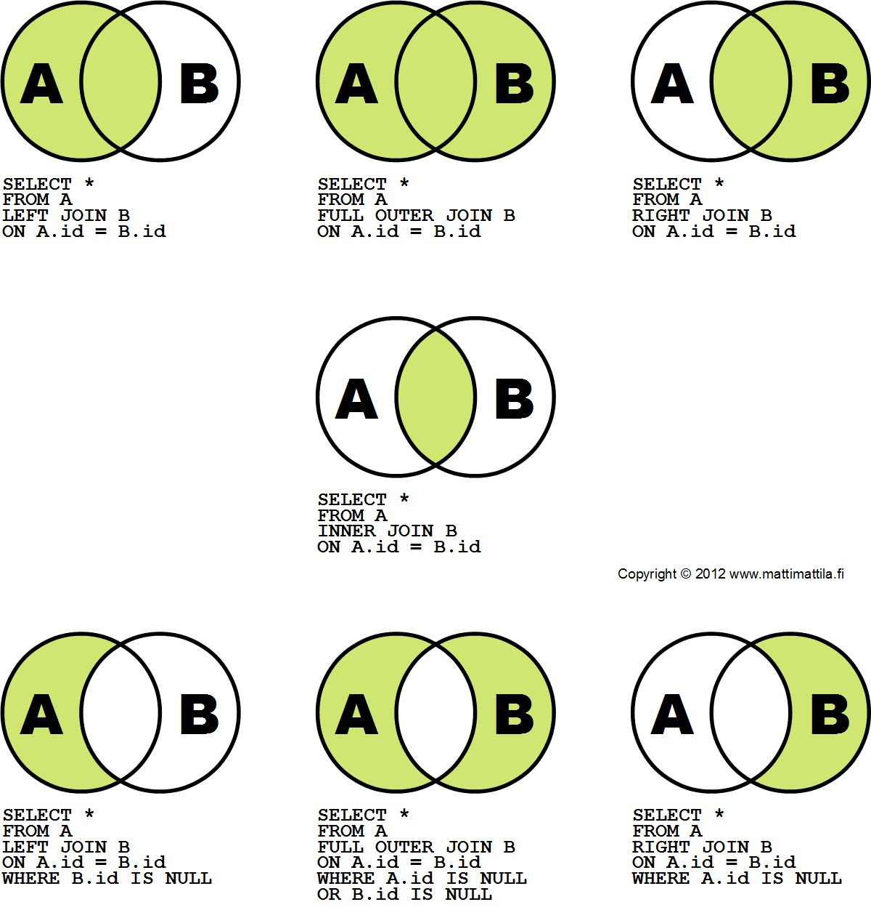
No Joins, wait what?

Slide 23
Deleting is painful at scale
- tombstones
- disk not reclaimed immediately
- increased I/O pressure
- sometimes big expensive scans needed

Slide 24

Monitoring will set you free!

Slide 25
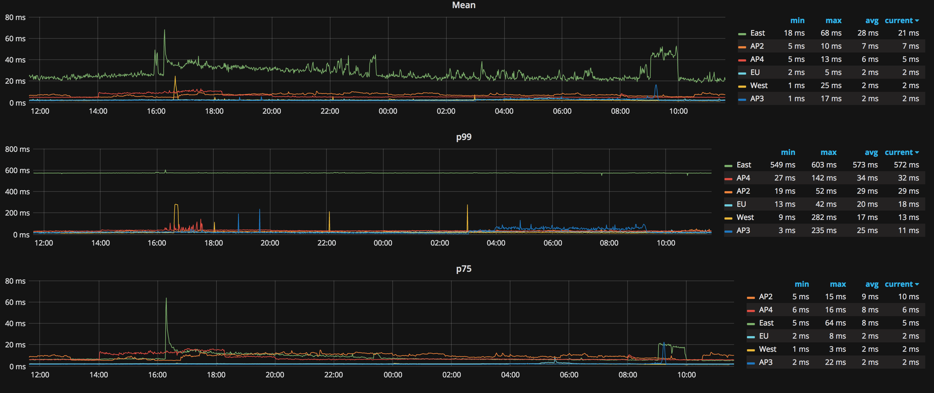
Monitor Read Latency

Slide 26
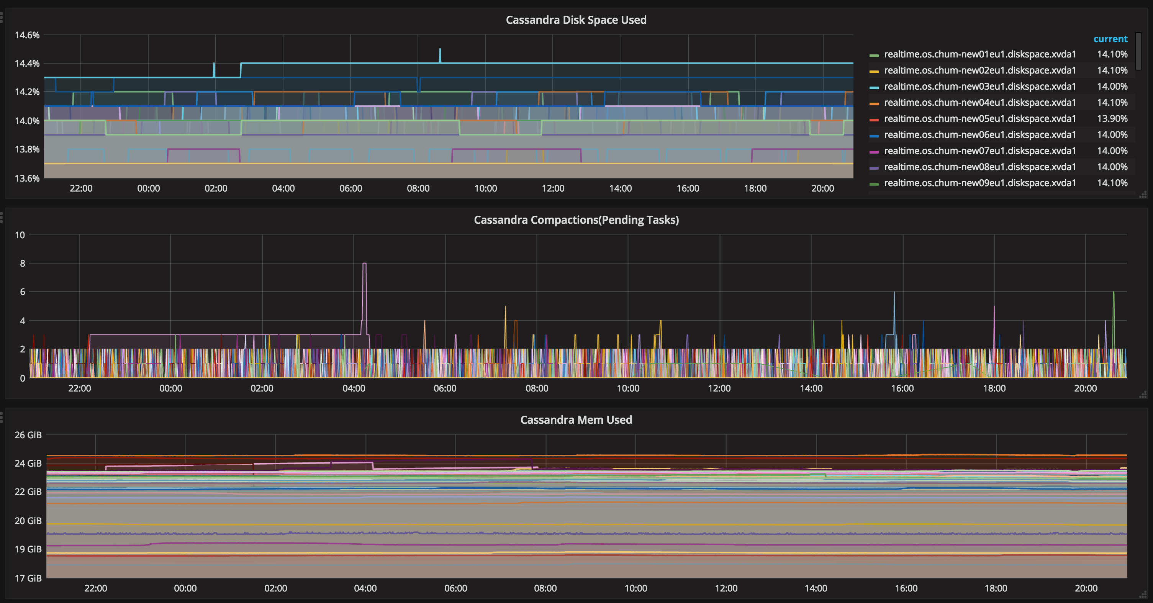

Slide 27
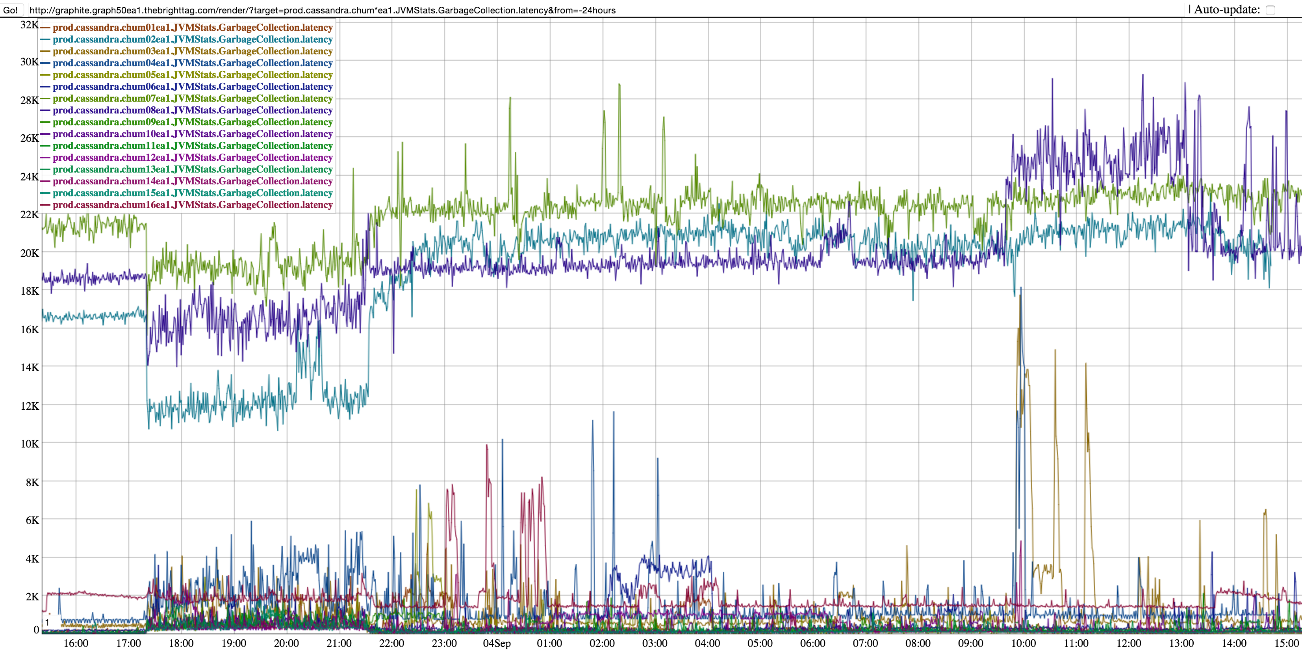

Slide 28




Slide 29


signal.co/careers
Hiring in Chicago and NYC office

Slide 30


Thank You!
acolovic@signal.co
@akicolovic

